Slide 1


Analytics Avenue For Research and Development
Talentena 2024 - ‘Wall of Visuals’ -Q1
Title : Dynamic Dashboard for Attrition Insights and Employee Retention using PowerBi

Slide 2
PROFILE
NAME : SHEIK MOHAMED SHAFEER
COLLEGE : VELTECH UNIVERSITY
DEGREE & DEPARTMENT : B.TECH COMPUTER SCIENCE AND ENGINEERING
RESUME LINK : https://bit.ly/Shafeer_resume

Slide 3
PROBLEM STATEMENT :
The HR department faces the challenge of understanding and mitigating employee attrition within the organization. The provided dataset offers crucial information, such as age, gender, and job roles, which necessitates the creation of a comprehensive Corporate Business Intelligence Analytics Dashboard using Power BI. This project aims to uncover attrition patterns by analyzing demographic factors, departmental trends, and the impact of business travel on employee retention. Additionally, it seeks to evaluate the role of training, work-life balance, and job satisfaction in attrition rates. The dashboard will delve into career progression indicators, such as time in the current role and manager tenure. By defining key performance indicators (KPIs) related to attrition, the goal is to equip HR professionals with actionable insights for strategic decision-making, ultimately fostering a more effective approach to employee retention.
APPROACH :
Cleanse & Transform Data
Plan Dashboard Layout
Visualize Demographics
Data Analysis and Insights
Deploy to Power BI
Project & Dataset Link : https://bit.ly/3rVyHNU

Slide 4
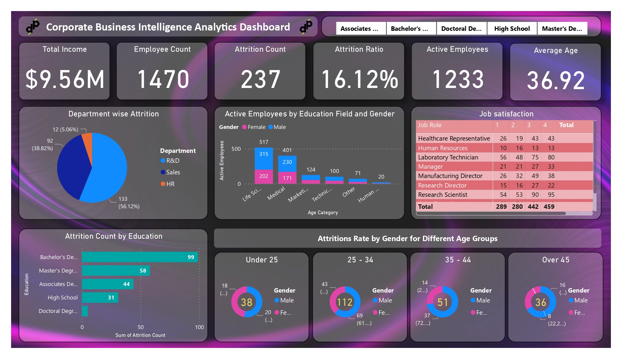
DASHBORAD PICTURE

Slide 5
KEY INSIGHTS
Comprehensive Data Integration: Successfully integrated diverse corporate data sources for a holistic view.
Visual Appeal and KPIs: Designed visually engaging dashboards with key performance indicators for effective decision-making
3. Trend Analysis: Applied data analytics to identify trends, patterns, and actionable insights within corporate data.
4. Cross-Departmental Insights: Provided analytics insights that span across different departments, allowing for a cross-functional understanding of business performance.

Slide 6
USE CASE DIAGRAM
PowerBi Analytics Dashboard
Data Integration & Transformation
Attrition Analysis
Departmental Insights
Employee Demographics
Performance Metrics
Work-Life Balance
User-Friendly Interface Design

Slide 7
Thank You
CONCLUSION
The user-friendly Power BI interface ensures accessibility for stakeholders, encouraging widespread adoption and utilization of the analytics dashboard. Cross-departmental insights foster collaboration by providing a holistic view of corporate performance, encouraging integrated decision-making.
In conclusion, the Corporate Business Intelligence Analytics Dashboard in Power BI emerges as a powerful tool for enhancing organizational efficiency, improving employee experiences, and facilitating strategic decision-making based on real-time and actionable insights.
shafeer5454@gmail.com

